Slide 1

Analyzing Weather Patterns and Predicting Snowfall for NJ
By: Justin Davis

Slide 2
Overview
Problem Statement
Approach
Data Collecting and Processing
Examination of the data
Predicting Snowfall
Takeaway

Slide 3
Problem Statement
According to the Federal Highway Administration, “State and local agencies spend more than 2.3 billion dollars on snow and ice control operations annually” (https://ops.fhwa.dot.gov/weather/weather_events/snow_ice.htm). Most spending is allocated on an as needed basis, however, if snowfall totals for the year could be predicted in advance, snow-related funding could be allocated upfront and more preventive measures could be put in place to reduce unnecessary spending.

Slide 4
Approach
Collect daily weather forecasts for NJ random zip codes from 01/01/2009 to 03/31/2020
Clean the data and aggregate to get summaries for each season and zip code
A season is defined as starting in October of one year and ending in March of the next year
Use K-means clustering to determine weather patterns across the state
Examine correlation between individual variables and snow
Build a predictive model using KNN regression to predict snowfall with less than or equal to 30% error

Slide 5
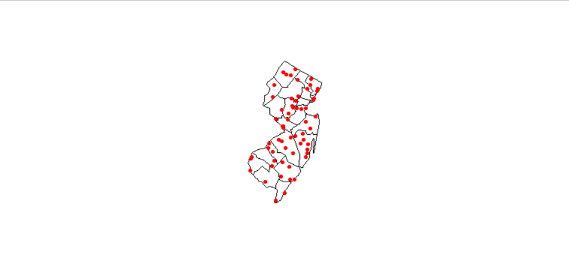
Collecting Data
Done using python
Getting all zip codes in NJ
zc = ZipCodeDatabase()
zipped_codes_nj = zc.find_zip(state='NJ')
uz_codes_nj = [z.zip for z in zipped_codes_nj]
Total number of NJ zip codes is 762
num_zips = len(uz_codes_nj)
Shuffle the zip codes
random.seed(10)
random.shuffle(uz_codes_nj)
Use 60 random zips
good_zips = uz_codes_nj[0:60]
Manually added 9 zips from S Jersey since it was heavily biased to N Jersey
Notes:
pyzipcode
Collect zip codes
Use a seed to reproduce results later
Only want 60 zip codes
Originally, randomization favored N Jersey – randomly add 9 zip codes from the south to spread it out
Zip codes that will be used are on the right

Slide 6
Collecting Data cont.
Data collected from https://www.worldweatheronline.com/
Registered (free) to get an API key to query
Collects forecast data for each zip code and exports it to a csv file
csv files were then loaded into R and compiled into a giant dataset
frequency = 24
start_date = '1-JAN-2009'
end_date = '31-MAR-2020'
api_key = 'cbb45e1ebda64725a11200528201004'
location_list = good_zips
hist_weather_data = retrieve_hist_data(api_key,
location_list,
start_date,
end_date,
frequency,
location_label = False,
export_csv = True,
store_df = True)
Notes:
Registered for multiple API keys – only can do 500 calls/day
Tedious to get data
R was used for the rest of the project

Slide 7
Data Cleaning
R was used for cleaning and examining the data
Remove unnecessary/repeated columns
data = subset(data, select = -c(visibility, uvIndex.1,
moon_illumination, moonrise, moonset, sunrise,
sunset, tempC, FeelsLikeC))
Convert degrees C to F
data$MaxTempF <- celsius.to.fahrenheit(data$MaxTempF, round = 1)
Convert metric lengths to imperial
data$TotalSnow_IN <- metric_to_inches(data$TotalSnow_IN, unit.from = "cm", 3)
Converted date column to a date object
Rename columns to match new units
Added column for average temperature
Notes:
Converted from metric to imperial units

Slide 8
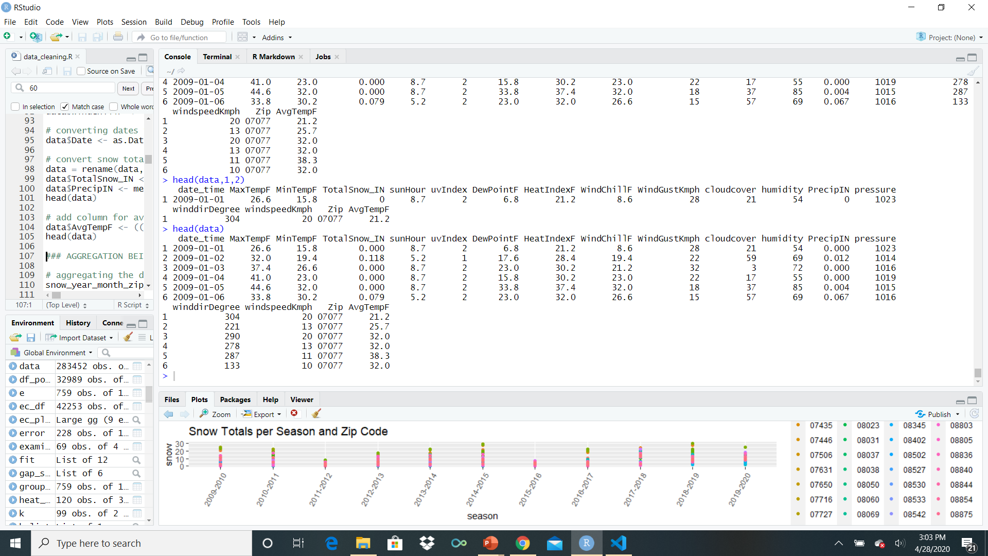
Cleaned Data
283,452 rows
18 columns

Slide 9
Aggregation
Get the monthly forecasts using the daily forecasts
snow_year_month_zip_date <- data %>%
group_by(Zip, yearMonth = floor_date(Date, "month")) %>%
summarize(snow=sum(TotalSnow_IN), prec=sum(PrecipIN), minTempF = min(MinTempF),
maxTempF = max(MaxTempF), avgTempF = mean(AvgTempF), avgSunHours = mean(sunHour),
avgUVIndex = mean(uvIndex), avgDewPointF = mean(DewPointF), avgHeatIndexF = mean(HeatIndexF),
avgWindChillF = mean(WindChillF), avgWindGustKmph = mean(WindGustKmph), avgWindSpeedKmph = mean(windspeedKmph),
avgWindDir = mean(winddirDegree), avgPressure = mean(pressure), avgHumidity = mean(humidity), avgCloudCover = mean(cloudcover))
Remove any entries that are not October through March (~ cuts data in half) from new dataset
Aggregate the new dataset every six rows (each six rows is now a season for zip)
Notes:
Data is nor cleaned, but we have daily forecasts. NOT helpful for prediction and for examining trends – aggregate to get monthly examinations
Most functions are getting average – some find the max, min, or sum
%>% function – pipe function
The dplyr library contains %>%

Slide 10
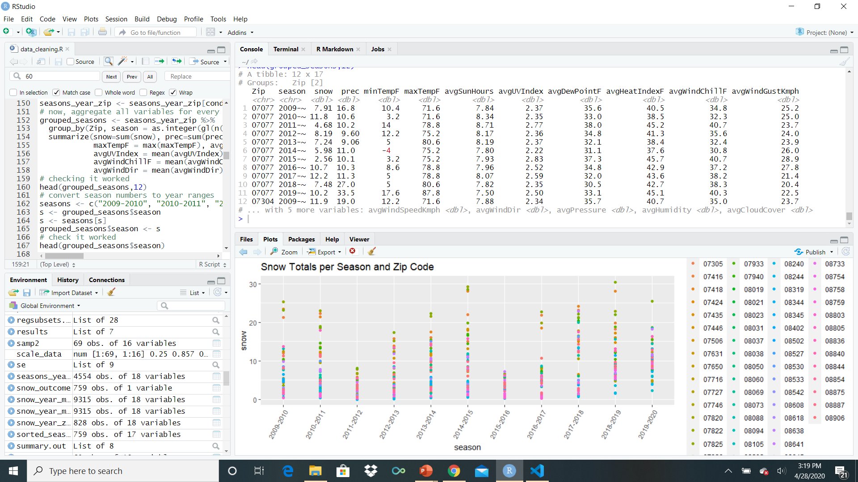
Aggregated Data
Notes:
This data will be used for prediction

Slide 11
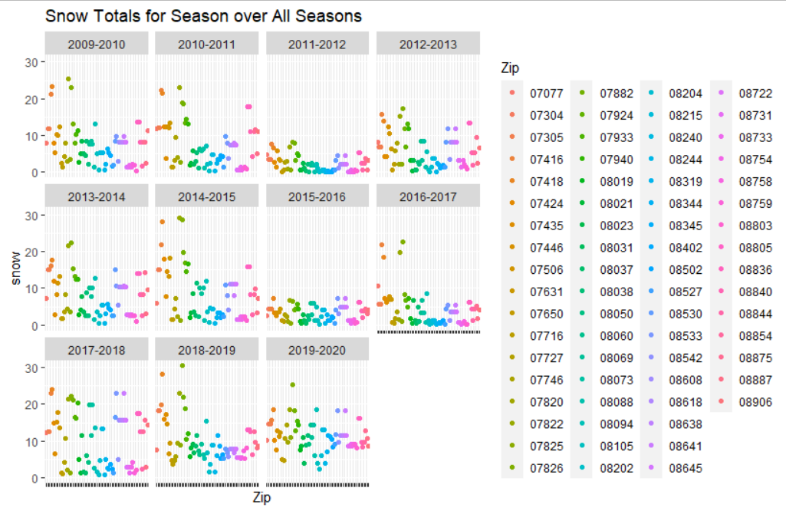
Snow Totals
Notes:
U-shaped trend
Some seasons, 2017-2018 and 2019-2020, don’t really

Slide 12
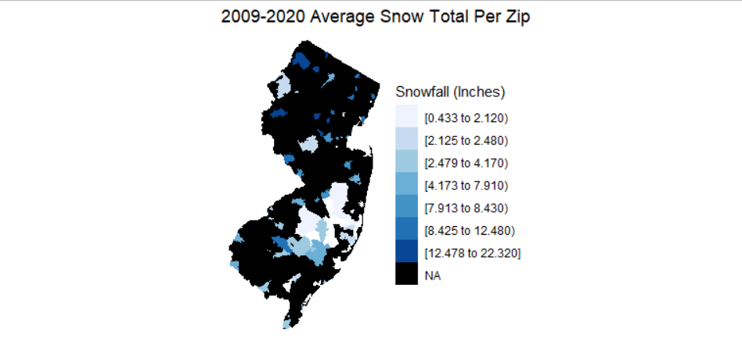
Visualizing Snow Totals
Notes:
See some trends here – northern zip codes have darker blues
Zip codes near the coast are lighter
Zip codes in the mid/south vary with amounts

Slide 13
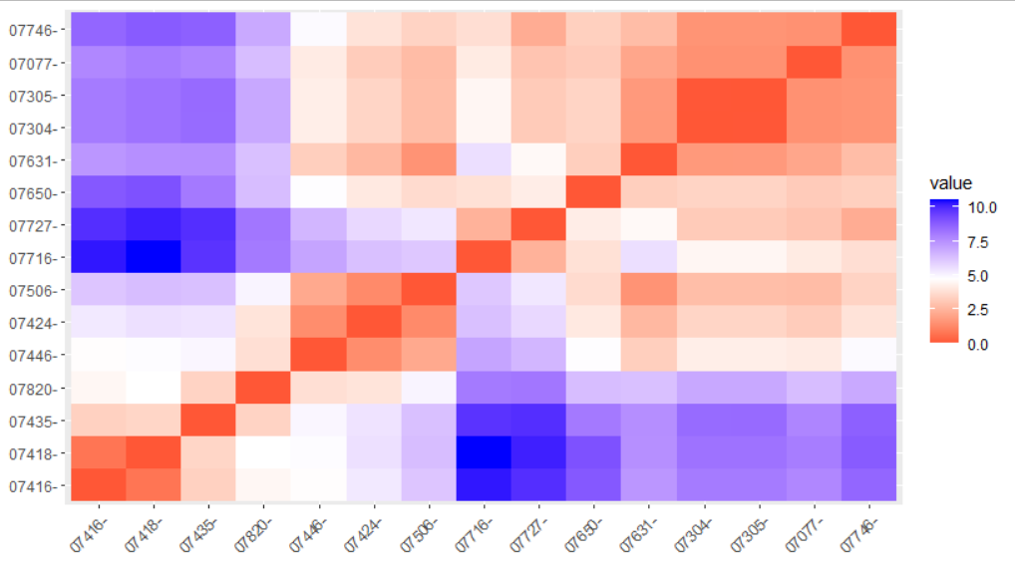
K-Means Clustering
Aggregated seasonal data to get average values for each zip over all seasons
The data was scaled so distance matrix could be calculated
‘factoextra’ library used to draw distance plot (subset of matrix below)
Notes:
There are similar weather patterns between zip codes, but what are those patterns?
Why k-means?
- fast, easy AND if we set a seed, we can make it repeatable!
Scale will calculate the mean and standard deviation of the entire vector, then "scale" each element by those values by subtracting the mean and dividing by the sd.
The distance matrix is only a subset – full one cannot fit on the screen
https://stackoverflow.com/questions/20256028/understanding-scale-in-r

Slide 14
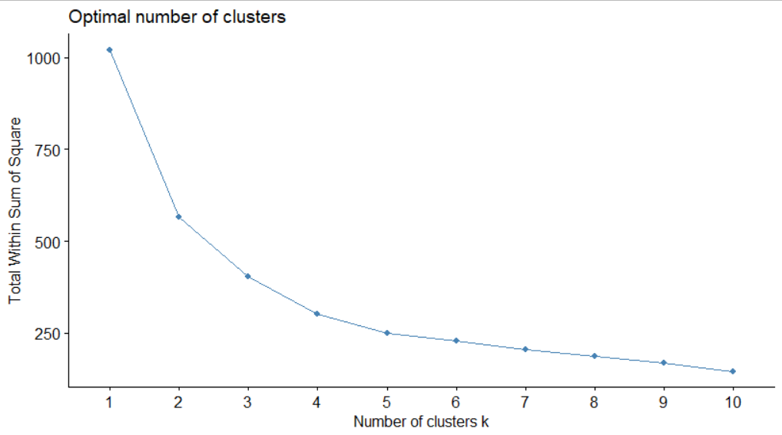
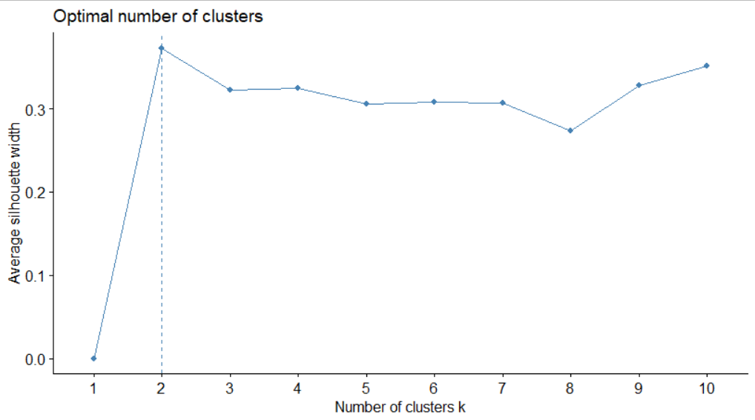
Determining K
Both elbow method and silhouette method used
Elbow method suggests k = 2 or 4, silhouette suggests 2 – visually, best clusters are at 4
Elbow
Silhouette
Notes:
The silhouette plot displays a measure of how closeness - has a range of [-1, 1].
Silhouette coefficients near +1 indicate that the sample is far away from the neighboring clusters. – another way to measure dissimilarity
A value of 0 indicates that the sample is on or very close to the decision boundary between two neighboring clusters.
Negative values indicate that those samples might have been assigned to the wrong cluster.
https://scikit-learn.org/stable/auto_examples/cluster/plot_kmeans_silhouette_analysis.html

Slide 15
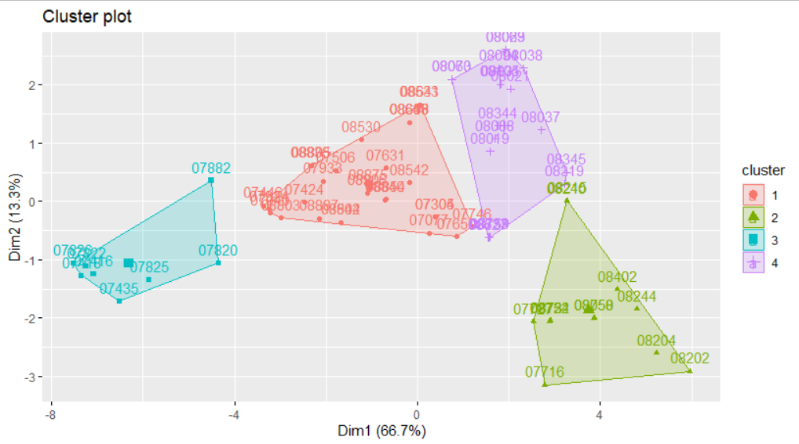
Clusters k = 4
Notes:
Can use fviz_cluster to graphically display clusters
Plots based on the two most important variables that determine clusters – Principal Component Analysis

Slide 16
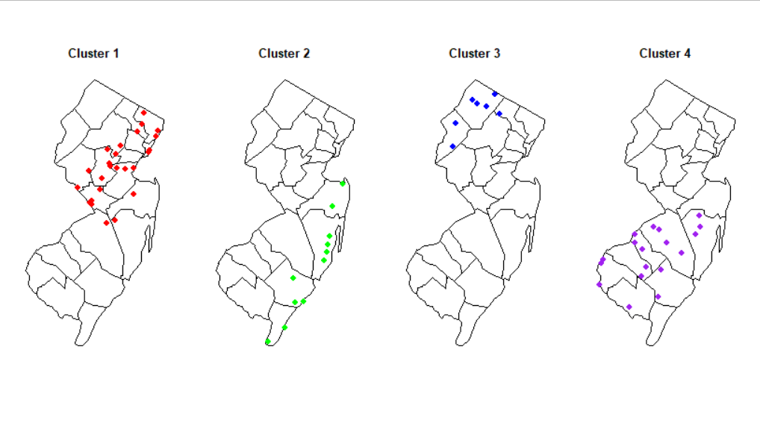
Clusters on the Map

Slide 17
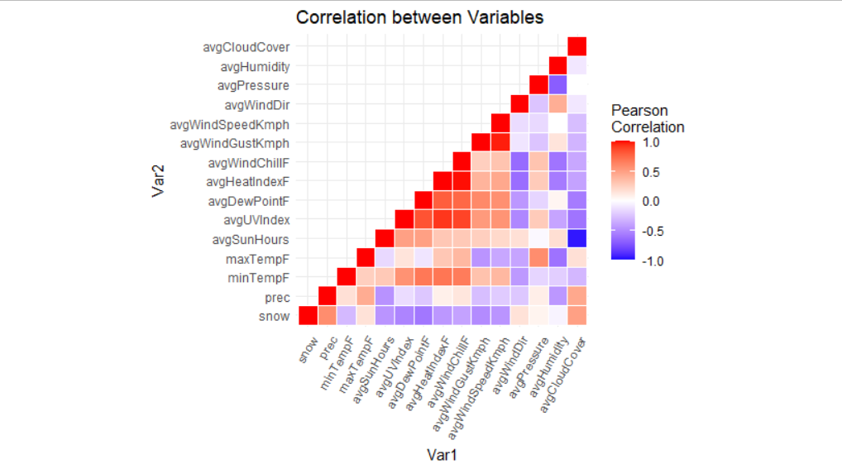
Correlation Between Variables
Before creating a model, what are the relationships between the variables?
Pearson coefficients between all variables were calculated
Notes:
It has a value between +1 and −1, where 1 is total positive linear correlation, 0 is no linear correlation, and −1 is total negative linear correlation.
A value of 1 implies that a linear equation describes the relationship between X and Y perfectly, with all data points lying on a line for which Y increases as X increases. A value of −1 implies that all data points lie on a line for which Y decreases as X increases. A value of 0 implies that there is no linear correlation between the variables.
https://en.wikipedia.org/wiki/Pearson_correlation_coefficient

Slide 18
KNN Regression
‘FNN’ library in R was used for this
Calculate the distance between the test point and k train points – based on distance, predict an amount
How was this done?
Scale data down so variables are in similar ranges
Extract columns of variables with positive Pearson correlation
Create testing and training sets – testing is 2019-2020 season, all previous seasons are training
Roughly 10/90 split
Find the best k – test values between 1 and 100 and use the one with the best accuracy
Notes:
Why knn reg?
Although it is a lazy learner, we don’t have many items in the training and testing sets, so it should be pretty quick – even if checking with 100 different k-values
Normally choose an odd k (break ties), but we are not classifying, instead using regression
Initially was going to use ALL variables to determine snow fall – had an increase of correct guesses when using the subset of variables
WENT FROM ~68% to 76%
The subset includes: "prec", "maxTempF", "avgWindDir", "avgPressure", "avgCloudCover“ (all variables that have a positive pearson coefficient value)

Slide 19
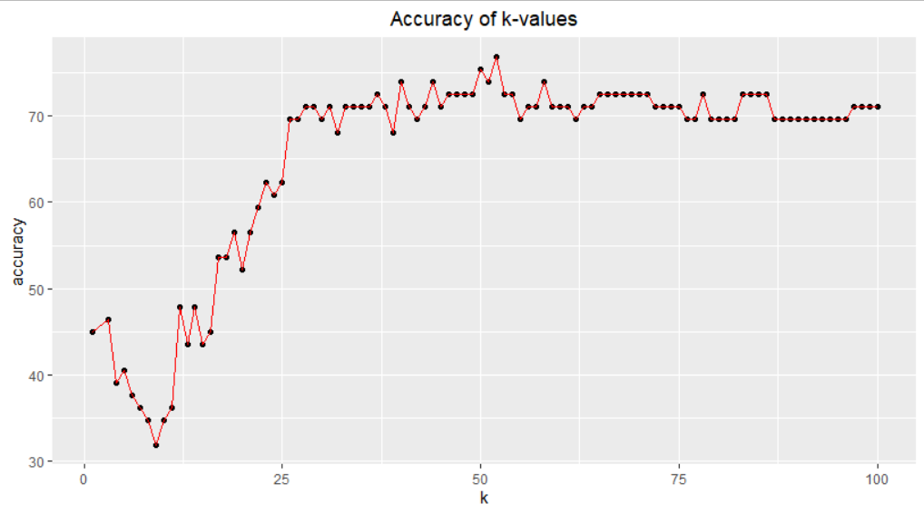
Choosing k
Notes:
In my case, k = 52 was the best choice (gives roughly 77% accuracy!
Accuracy again, in my case, is if the predicted value is within 30% of the actual value

Slide 20
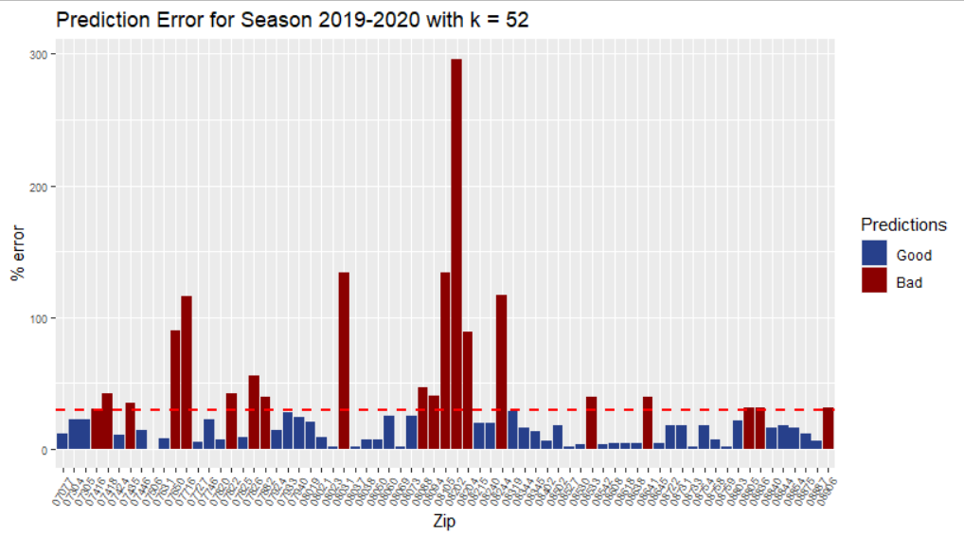
Error % Plotted
Notes:
A lot of wrong predictions are near the deciding line – only a few have a very large error!

Slide 21
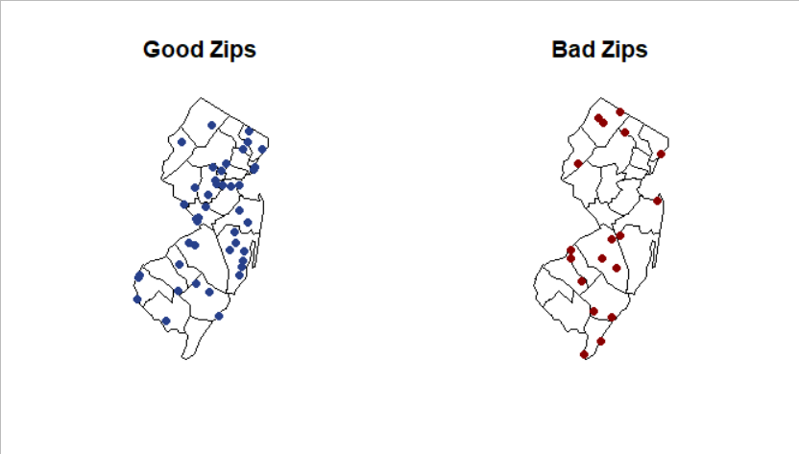
Mapping Predictions

Slide 22
Take Away and Improvements
Used forecasted values – real values would probably have differed
K-means clusters make sense!
Only used 69 out of 762 zip codes – about 10% of all the zip codes
Most zip codes are up north, so predictions are probably skewed toward those values
KNN regression model is decently accurate – model had an accuracy of ~ 77% to guess snow totals within 30%!
However, predicting snow fall is hard!
Saw improvement when predicting 2019-2020 season only, as opposed to both 2018-2019 and 2019-2020
Most likely because more data formed the model
More training and testing data would help

